Slide 1



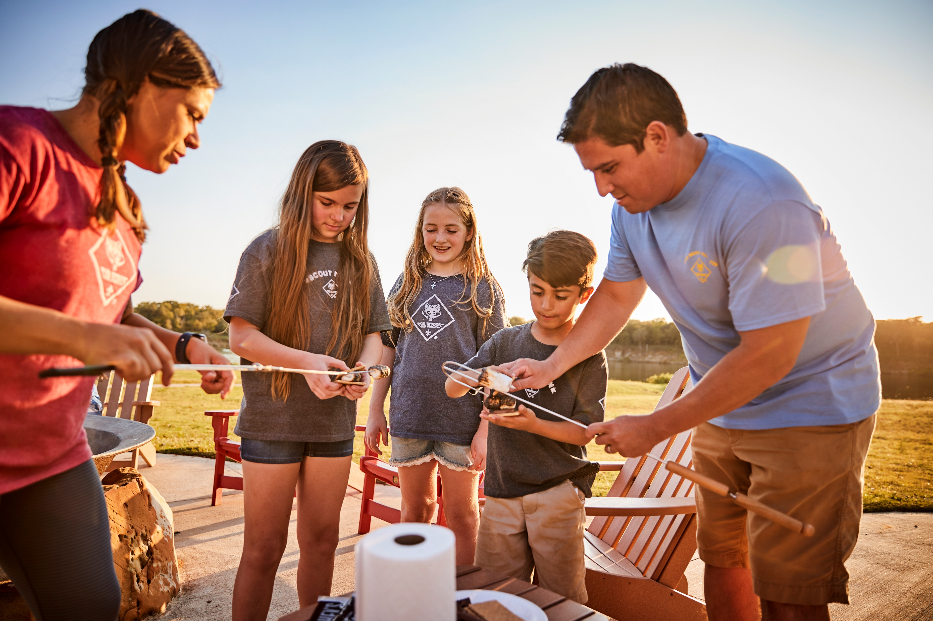
2024 District Cub Scout Recruitment Campaign:
Get Out & Cub Scout
Pack Leader Training/Kickoff

Slide 2

Welcome, Introductions https://youtu.be/AmLbS_CqHMU & Safety Moment

Slide 3


Safety Moment
https://www.scouting.org/health-and-safety/safety-moments/gss/
ONLINE VERSION LINK: https://www.scouting.org/health-and-safety/gss/toc/

Slide 4



Council & District Goals
Pack Recruitment Chair Job Description
Notes:
Review the need to grow our Scouting program.
Fulfilling our mission of reaching as many young people as possible….
The last 2 years we had a 31% growth. Our goal this year is to continue that growth trajectory and reach as many young people as possible.
Our overall goal is 3,000 youth recruited.

Slide 5

Sign-Up Night Prep & Promo Begins Now!! Promo & Materials Review

Slide 6

Sign-Up Night Materials, Promotion, and Preparation

Slide 7




Parent Flyer (1st Flyer)
Youth Flyer (2nd Flyer)
Youth Flyer (2nd Flyer)

Slide 8


Posters
Yard Signs

Slide 9

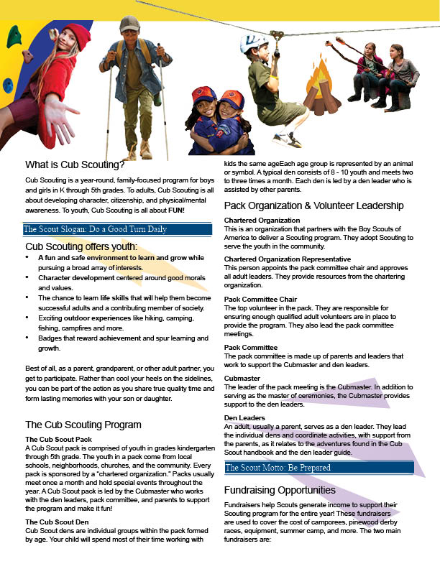


Parent Orientation Guide

Slide 10


Fall Adventure Ticket
Youth Flyer (2nd Flyer)
FRISBEE

Slide 11


Sign-Up Nights: Schools/Scheduling & Execution of Sign-Up Agenda: https://youtu.be/-YbOtmCjdCE

Slide 12
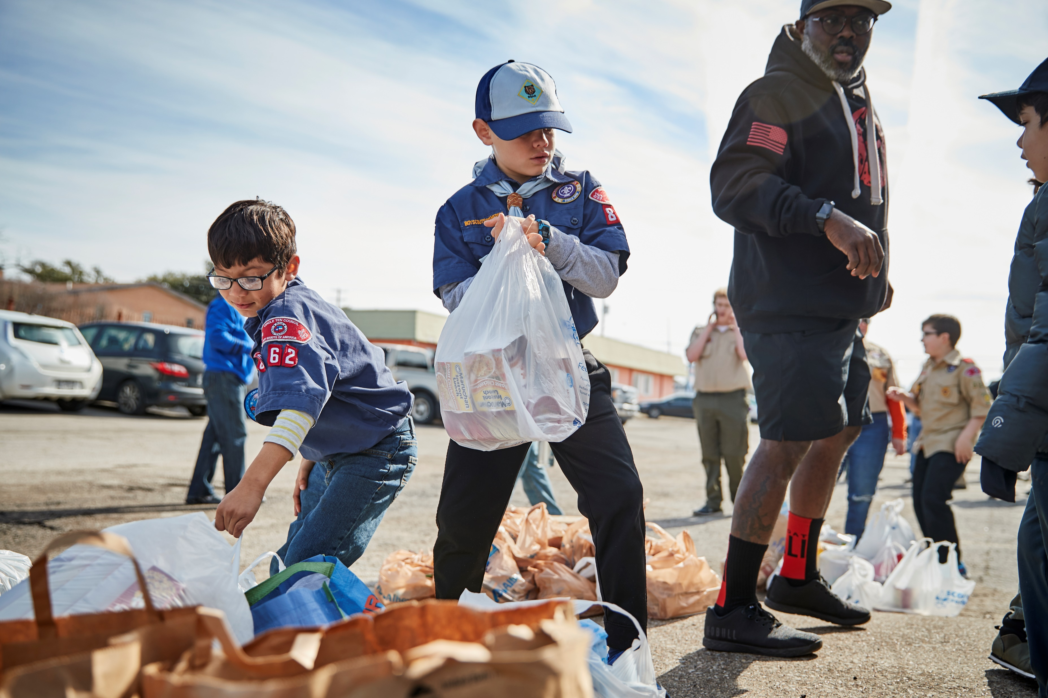
How to Recruit Leaders using your Pack’s Sign-up Night for New Families: https://youtu.be/hlRfpwi82Co Example of a segway/approach for recruiting adults, “The Yardstick Approach” Video: https://youtu.be/A7cVCZ5o8CI

Slide 13

Parent Orientation

Slide 14
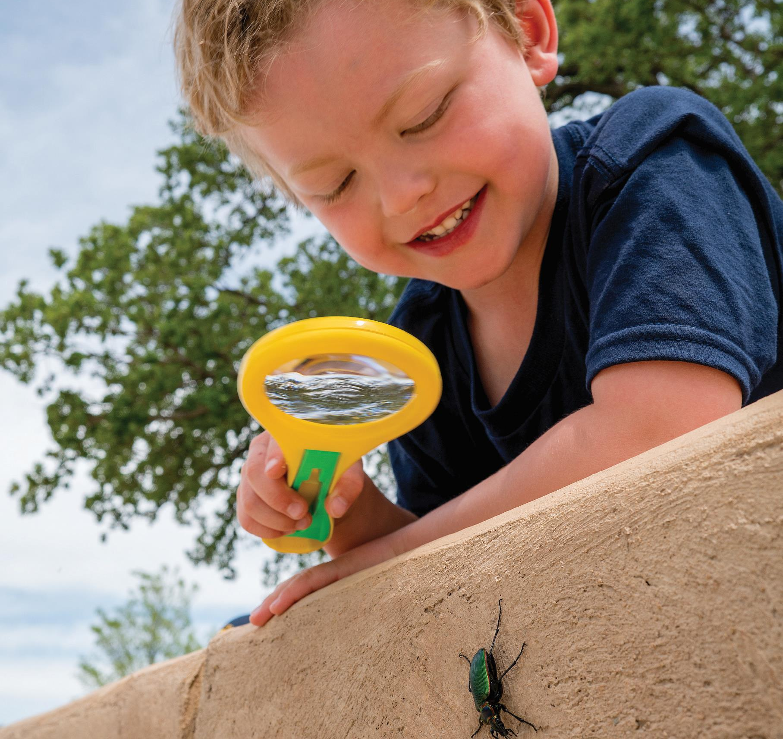
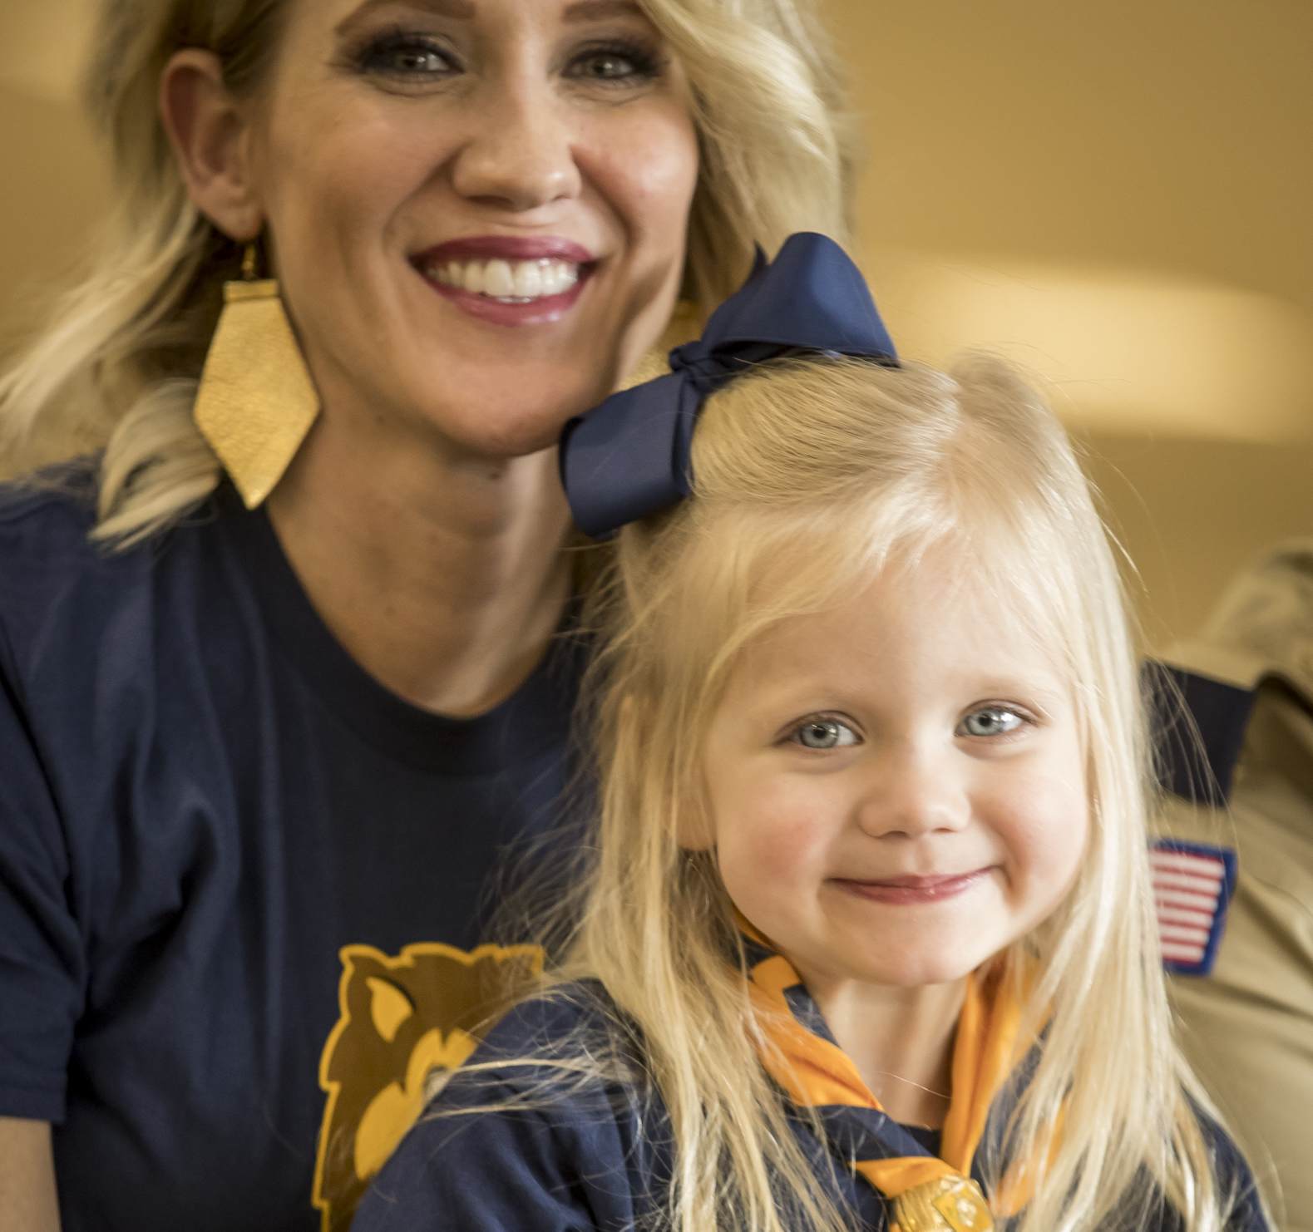
Fees, Registration, & Paperwork

Slide 15
NEW THIS YEAR! ONLINE REGISTRATION INCENTIVE & WELCOME PACKET FOR NEW MEMBERS
ALL new Cub Scouts who register via BeAScout.org/”Online” from August 1 through October 31, 2024, will receive a special Welcome Kit in the mail shortly after completing registration.
This Welcome Kit contains:
One car magnet
One sticker (for a water bottle)
One Scout Life Mini Magazine
A Peer-to-Peer Recruiting card that provides details on how to recruit a friend into Cub Scouts and earn a FREE Recruiter Strip Emblem.

Slide 16

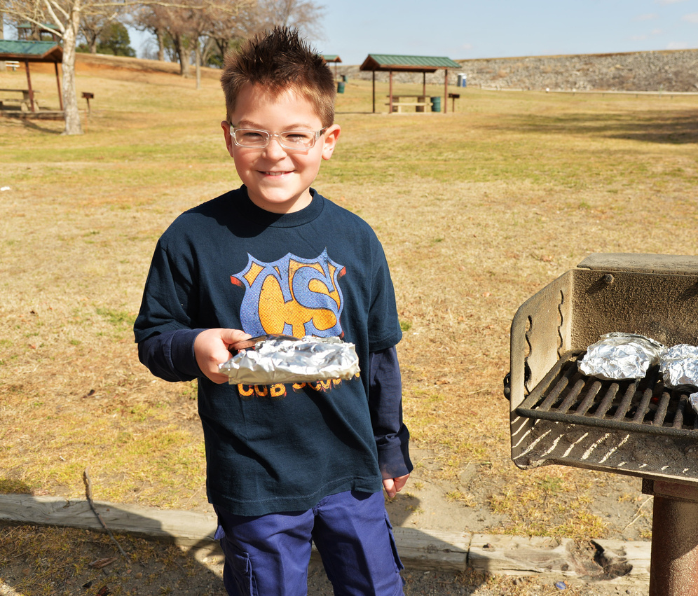

Online Resources: https://lhcbsa.org/cub-recruitment/

Slide 17
Additional Questions & Q & A Adjourn

