Slide 1
TO THE PRESENTER(S):
You are invited and encouraged to:
  Catch the imagination of your audience.
  Excite them about the program and show them the possibilities.
  Set the stage for units to embrace the New Member Coordinator position.
  Use these instructor notes and the notes below to help you to prepare.
Notes:
[Slides #1 through #3 are for the presenters only. The presentation begins with slide #4 – the title slide.
[Do your best to make friendly, welcoming connections with the audience immediately and throughout the presentation. Be as interactive as possible, so that participants are engaged in thinking about how the ideas resonate for them personally.
Use the notes at the bottom of slides to guide you. Information in italics and/or brackets [like this] is for you alone. Suggestions for what you will say are in regular type rather than italicized or in brackets.

Slide 2
TO THE PRESENTER(S):
This training module is designed to be presented:
by a district membership chair and/or other members of the council/district membership or commissioner teams
using a face-to-face, teleconference, virtual go-to-meeting, or webinar format with as much participant interaction as possible
in a visit with unit leadership or at a unit committee meeting, Roundtable, University of Scouting, district membership team meeting, or other gathering.
Adaptability is key. Be ready to personalize and adapt to the audience and situation.
Notes:
[Slides #1 through #3 are for the presenters only. The presentation begins with slide #4 – the title slide.]
Remember that your enthusiasm and energy will be contagious. Please keep reminding yourself that you are setting the stage for units to embrace membership growth through New Member Coordinators.
Move quickly through the slides. Many are designed for quick visual impact and do not require discussion. Tailor your overall timing to the situation.
If you are a member of the local district, please prepare for a continuing role mentoring and supporting New Member Coordinators and their units. Learn from the online training for New Member Coordinators on the e-learning site, and be sure to take the district membership team supporting the NMC. ]

Slide 3
TO THE PRESENTER(S):
Keep in mind that the audience:
should include the Unit Key 3 (Scoutmaster, Troop Committee Chair, Chartered Organization Representative) and other influential unit adults - to the extent possible
will probably have familiarity with the unit dynamics
will probably have some knowledge/experience in Boy Scouting but may or may not be trained
is likely to include millennial parents, who, as a group:
  Have strong core values in keeping with Boy Scout values
  Set high standards for organization and preparedness
  Expect to volunteer after a gradual welcome and orientation process
  Work best as members of a team
Notes:
[Slides #1 through #3 are for the presenters only. The presentation begins with slide #4 – the title slide.
Show the members of the audience that they are valued. Help them to feel a sense of belonging. We are all part of an inclusive community, and our demographic differences make us stronger as a group. This idea should be communicated through our welcoming attitude even more than through what we actually say.]

Slide 4
Learning Objective
Understand how New Membership Coordinators can help TROOPS attract and keep more youth and volunteers
Notes:
This presentation is designed to introduce the concept of the New Member Coordinator position, and explain how it can help a Scout Troop attract and retain more youth members and adult volunteers.

Slide 5


We’re happy you
could join us.
6
Notes:
PRESENTERS: In a group presentation setting, please use this slide as the “screenshot” showing in the room while everyone is gathering.
Establish the feeling of belonging immediately – through hospitality, greetings, and introductions, to the extent possible in the setting. Set the scene for friendly, helpful discussion and sharing of ideas.
If sharing with just one individual, such as a unit Committee Chair, then start with the next slide.

Slide 6
Introduction to
New
Member
Coordinator
For Troops
Notes:
Hello, my name is _________________________ and I’m the ______________________ (define Scouting role as it is relevant to THIS presentation/audience).
Thank you for sharing your time with me today as I introduce you to an exciting, new opportunity in adult leadership.

Slide 7
WHAT IF…
6
Notes:
Think about the beginning of your recruitment year. It’s a busy time for everyone. Not only are youth excited about seeing old friends and meeting new ones, their parents are looking for engaging and challenging opportunities in which their children can participate. Many of these parents are also interested in becoming involved in their child’s extra-curricular activities. We all know there are many different activities that vie for the attention of today’s youth—sports, music, drama… What if (dramatic pause) these parents are looking at Scouting? Are you ready to recruit?
If not, you need to get ready!
Because we know you have many things vying for your attention, Scouting has introduced a new idea for units, which is easy to implement and can make a world of difference for both you and your troop. It’s a new position…

Slide 8

NEW
MEMBER
COORDINATORS
Notes:
There is a new idea for units which IS easy to implement and can make a world of difference to your unit, and it’s called the NEW MEMBER COORDINATOR.

Slide 9
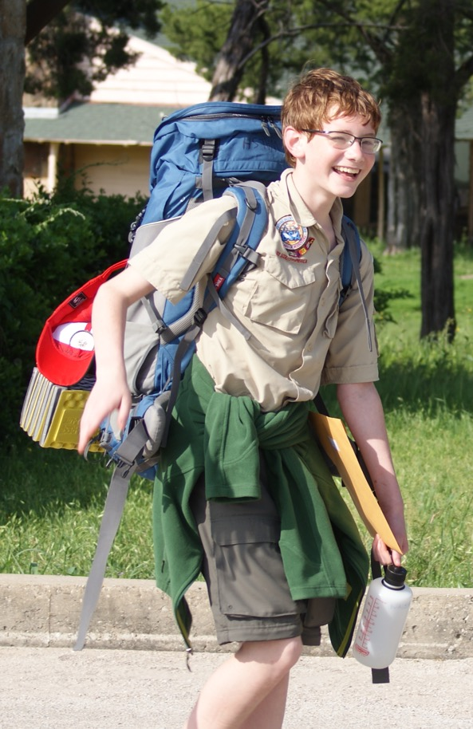
What was it like
for your family
when you
first joined
a troop?
Notes:
Let’s begin by thinking back to the days when you first joined a troop.

Slide 10


EXCITED?
CONFUSED?
Notes:
Were you excited? Meeting new people and anticipating new experiences can be very exciting. Were you confused? There are a lot of great people and wonderful volunteers involved in Scouting. Did you understand all the roles and responsibilities of the adults involved? How does an adult determine where they fit in?

Slide 11

NEW FAMILIES OFTEN HAVE QUESTIONS and
CONCERNS
Notes:
What are the typical questions and concerns a new family would experience when joining a Troop?
(With an interactive, fact-to-face presentation, ask for audience ideas. Write responses on chart paper or have a volunteer write on the chart paper.)
Now that you have been part of a Troop for a while, what have you seen that helps you identify the concerns new youth and families may have about the troop?

Slide 12


WHAT MAKES
THE DIFFERENCE
IN THE
FIRST FEW
WEEKS?
NOT SO SURE …
… LOVING IT!
Notes:
What makes the difference in those FIRST FEW WEEKS IN THE TROOP?
(With an interactive, face-to-face presentation, lead a discussion on what does make the difference during the first weeks of a youth joining a troop. Have someone list the feedback on chart paper. With a larger group, put participants into smaller groups and have them create a list of what makes the difference in those first weeks and let each group present their thoughts. With a very large group and /or a more formal presentation, announce that this a pause for reflection and suggest that participants write down some ideas.)

Slide 13


Notes:
It begins with realizing what makes Scouting such an EXCELLENT EXPERIENCE overall.

Slide 14
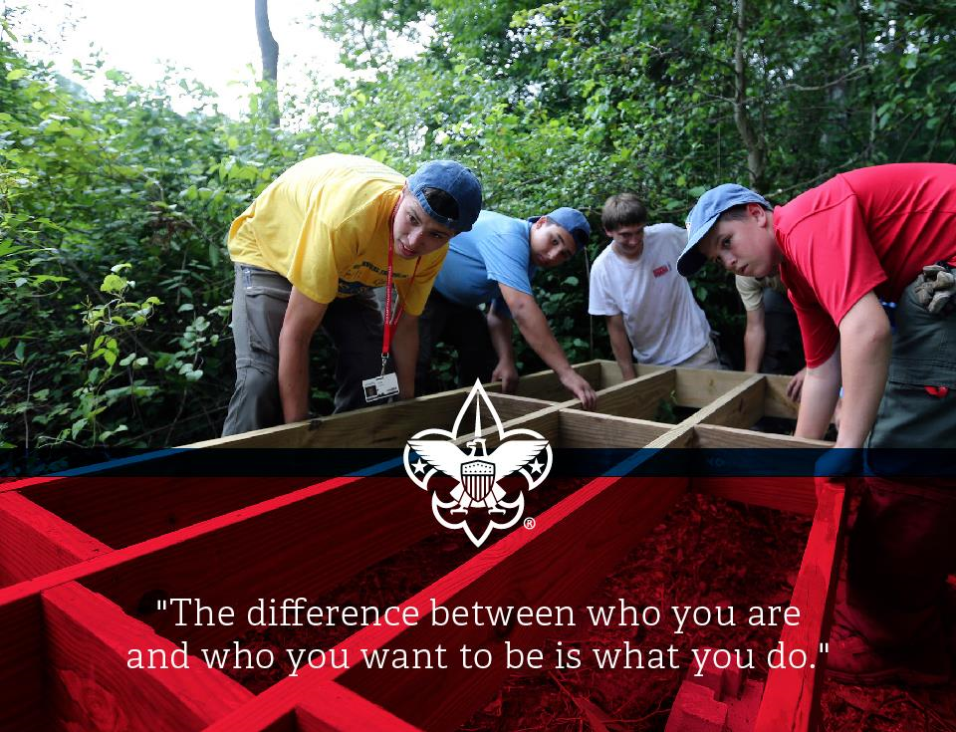
LEAD
LEARN
SERVE
DEVELOP
Notes:
More than just an extra-curricular activity, more than just a fun get-together … SCOUTS LEARN, LEAD, SERVE and DEVELOP …. at each and every meeting, activity and event. The kind of things Scouts do and learn, they can’t do and learn anywhere else!
(Share some examples of the types of activities Scouts do to learn, lead, serve, and develop themselves, better yet, if you have any Scouts in attendance have a couple share some of the activities they have done to learn, serve, and develop themselves.)

Slide 15
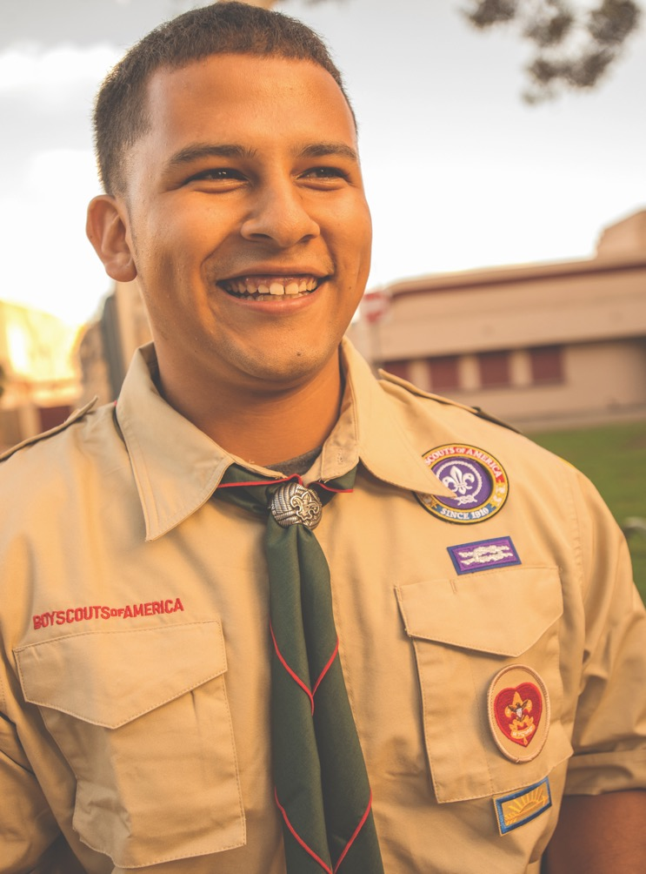
How does
SCOUTING
MAKE A
DIFFERENCE
for a youth
LONG-TERM?
Notes:
Share some of the key benefits you see Scouting delivering.
(Gather key ideas and quickly summarize. You may want to have a scribe write the benefits on chart paper or a whiteboard.)
Scouting helps youth have fun, learn life-long skills, and build lasting friendships. A recent, independent research study concluded that being a Scout makes a significant difference in a youth’s character and leadership development.

Slide 16
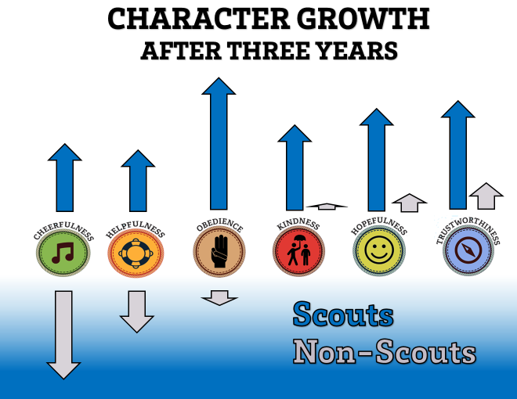
[insert photos of Scouts in action and members of sports teams’ with participation trophies]
Notes:
Of course, some people want PROOF, some tangible evidence. A recent independent study, by Tufts University, showed that after only three years in Scouting, youth are more likely to prioritize doing the right thing and helping others. Youth not involved in Scouting, including those who participate in sports, experienced a decrease, or little growth, in positive character traits.
(The Tufts Study measured 11 character attributes in 3,000 Scouts and 1,000 non-Scouts over 3 years. After 3 years, significant increases in cheerfulness, helpfulness, kindness, trustworthiness, and hopeful future expectations were reported for Scouts. Among non-Scouts, those character traits actually declined.]

Slide 17

WOULD YOU
LIKE TO…
Notes:
(Go through the next three slides quickly.)

Slide 18
Give OTHERS the opportunity to
EXPERIENCE SCOUTING?

Slide 19
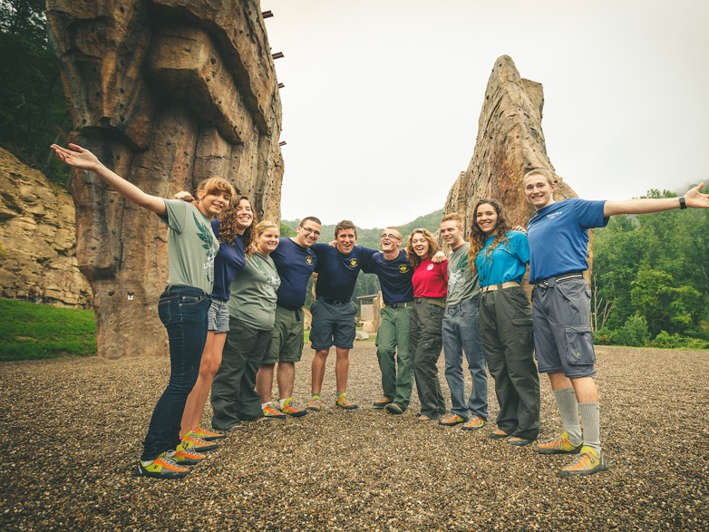


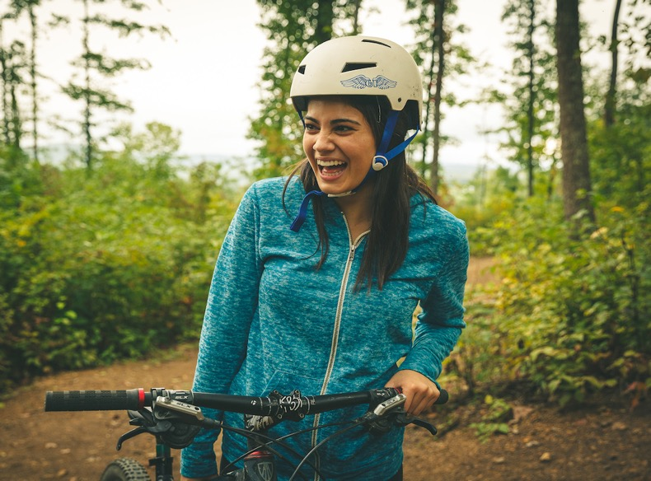
Notes:
Give others the opportunity to experience Scouting…

Slide 20
DECREASE
The number of families who leave soon after
joining the troop?

Slide 21

Have
MORE
ADULT
VOLUNTEERS
to help you?

Slide 22
If YOU
ANSWERED
YES
to any of these,

Slide 23

THEN A
NEW
MEMBER
COORDINATOR
is right for YOU!

Slide 24
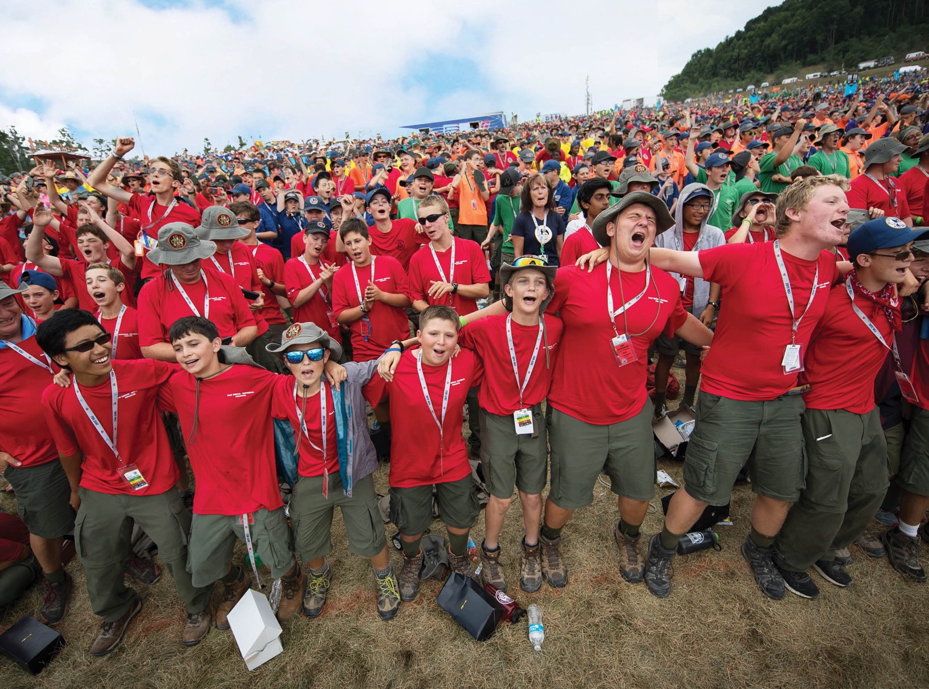
NEW MEMBER COORDINATORS
SHARE THE BENEFITS
OF SCOUTING
Notes:
New Member Coordinators share the benefits of Scouting. They tell the story of why Scouting is a worthwhile and valuable activity for both youth and families. Think about what you have personally seen that convinces you of the value of the Scouting. Turn to the person sitting next to you and share an experience you have had with Scouting that illustrates its value to youth.
Ask someone to share their experience with the group.
These are the kinds of messages that New Member Coordinators share – on social media and in person.

Slide 25
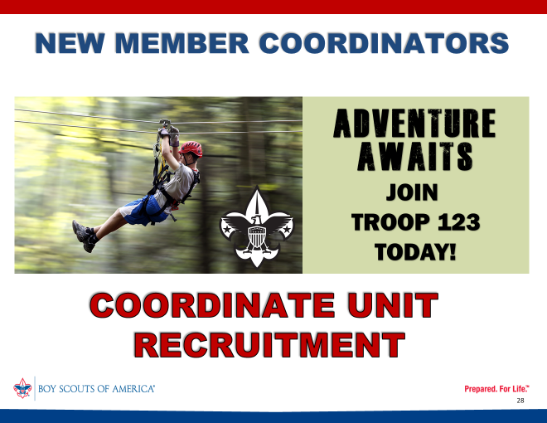
Notes:
They assist unit leadership with organizing recruitment activities and help to invite youth and families, making sure everyone has an opportunity to join Scouting.

Slide 26
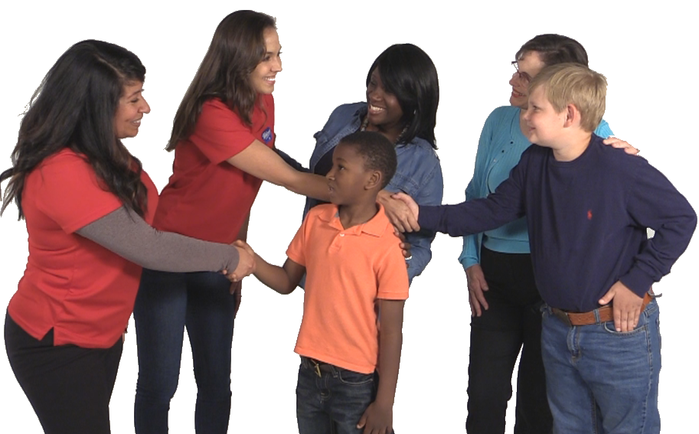
NEW MEMBER COORDINATORS
GUIDE JOINING & WELCOMING
Notes:
New Member Coordinators guide joining and welcoming by assisting new families, making them feel welcome and comfortable in their new Scouting family.

Slide 27


NEW MEMBERS
JUST
WANT TO
“FIT IN”
Notes:
Think about it…New Scouts and their families went through a selection process to find your troop, and once they have joined, both the Scouts and their parents just want to “fit in”.
(Click the powerpoint to change the red image to blue.)
Helping new families feel a sense of belonging and “fitting in” is the primary role of the New Member Coordinator. When a friendly and welcoming New Member Coordinator anticipates and addresses parents' questions and concerns, parents are much more likely to feel positively about their Scout's initial experiences and will encourage their Scout to continue in Scouting. A friendly face greeting a new Scout and their parents as they arrive for meetings helps everyone get over the initial “butterflies” about joining a new group. By just being there, being available for questions and conversation, the New Member Coordinator makes a huge difference in a new family’s transition into the troop.

Slide 28

NEW MEMBER COORDINATORS
ARE EASILY IDENTIFIABLE
Notes:
With this new logo on their shirts, New Member Coordinators are easily identifiable to all guests and new families. They stand out from the crowd of leaders in their uniform shirts. Your unit can choose how to identify your New Member Coordinators and how the logo is worn.

Slide 29

NEW MEMBER COORDINATORS
BELONG TO A TEAM
Notes:
New Member Coordinators belong to a team. More than one person may be registered as a New Member Coordinator and, actually, the position is designed for a team approach. Being part of a team allows more people to contribute and take ownership of the troop’s goals and planning.
Besides that, clearly many hands make light work, and being involved is more appealing when you have others working with you to accomplish a goal!

Slide 30

NEW MEMBER COORDINATORS
SELECT WHAT THEY
LIKE TO DO
social media
organizing
hospitality
welcoming
answering questions
greeting
Notes:
New Member Coordinators select what they like to do. Teams allow each person to pick their area of focus – to do those aspects of the role that appeal to them personally and suit their skill set, talents, and personality. The role of the New Member Coordinator is FLEXIBLE and ADAPTABLE to the individual volunteer.

Slide 31

NEW MEMBER COORDINATORS
ARE SUPPORTED BY THEIR
UNIT, DISTRICT, AND COUNCIL LEADERSHIP
Notes:
New Member Coordinators don’t have to “go it alone.” They have the support of their unit, district and council leadership, including the COMMISSIONER staff. Training is available on Scouting U. Council level support includes ready-made marketing resources. The District Committee, the District Membership Chair, and Commissioner staff can provide training, coaching and mentoring.

Slide 32

BUILD
YOUR
TEAM!
Notes:
It’s not hard to build your New Member Coordinator team. It’s mainly a matter of inviting members of your unit to specifically welcome guests and new members.

Slide 33
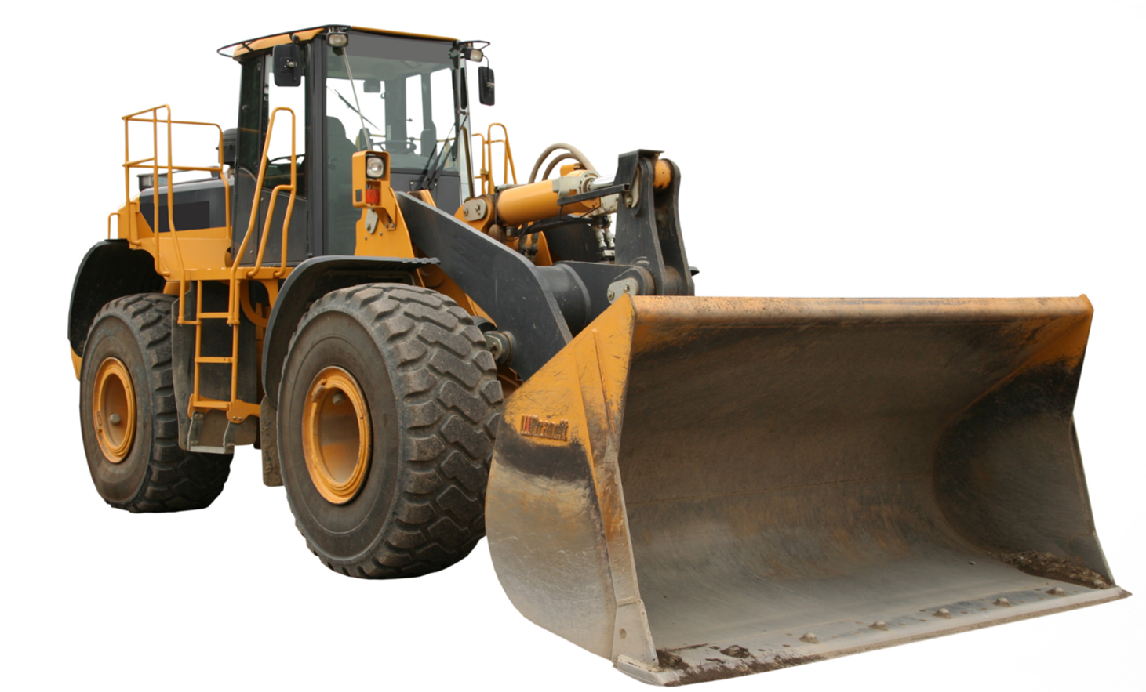
AN
EASY JOB
TO FILL
Notes:
Believe it or not, New Member Coordinator is an EASY job to fill. It’s perfect for someone who may have no other volunteer roles within the troop. Experience isn’t required and training is short. Most people already possess the main qualifications: A WELCOMING SMILE and OUTGOING PERSONALITY, someone who likes to meet and talk with people, someone who likes to make new friends. In fact, I bet you may already have some great candidates in mind!

Slide 34
YOU MAY
ALREADY HAVE
GREAT CANDIDATES
Notes:
Who in your troop might be just right for this position? I bet you can think of three or four people right away who would be GREAT! Here are a few hints to get you started ….

Slide 35

WELCOME
Notes:
Many, if not most, parents of today’s children and young teens are millennials - that is, they came of age in the year 2000 or later. Millennial parents are exactly what Scouting needs! They have strong values that support Scouting values, including wanting to help others. They are focused on being ”prepared”-- sound familiar? They bring a wealth of tech-savvy and team-building skills, and they’ve been volunteering all their lives!
That said, we welcome New Member Coordinators of any generation.

Slide 36

NEW MEMBER COORDINATORS
HELPFUL
Friendly, Courteous
and Kind
Notes:
A good candidate for the New Member Coordinator position is someone who is at ease with meeting and talking to new people. Someone who is outgoing and friendly, who always has a smile. Right now, jot down the names of a few people you know who embody the Scout Law of Helpful, Friendly, Courteous and Kind. These will be the people you will want to contact.
Provide a couple of minutes for participants to write down some names.

Slide 37

NEW MEMBER COORDINATORS
ARE CARING AND RESPONSIVE
Notes:
Another positive trait of a good candidate for this position is someone who is caring, responsive, and good with follow-up. New families have lots of questions, and the New Member Coordinator needs to be available as a continuing point of contact after they join, willing to check in with the new members and see how they are doing, and answer questions as they arise.

Slide 38

NEW MEMBER COORDINATORS
ARE TECH SAVVY
Notes:
Who’s always posting and sharing photos of the troop in action? A tech-savvy parent who loves social media would be a great member of the team. In many ways, they are already “doing the job” just be doing what they like to do anyway -- using today’s technology to share moments and memories, to invite others to join in, and to stay connected with family and friends.

Slide 39

NEW MEMBER
COORDINATORS
MAY BE
NEW TO SCOUTING
Notes:
While some experience with the Scouting program is a plus, it is NOT a prerequisite. It’s OK for new member coordinators to be new to Scouting. The key here is enthusiasm. It’s contagious! A New Member Coordinator doesn’t need to know ALL the answers, they just need to be willing to follow-up and find out.

Slide 40


Notes:
Sometimes new families leave Scouting before they barely get their feet in the door!
New Member Coordinators are the solution to many of the issues troops face when integrating new families into the Scouting program.

Slide 41

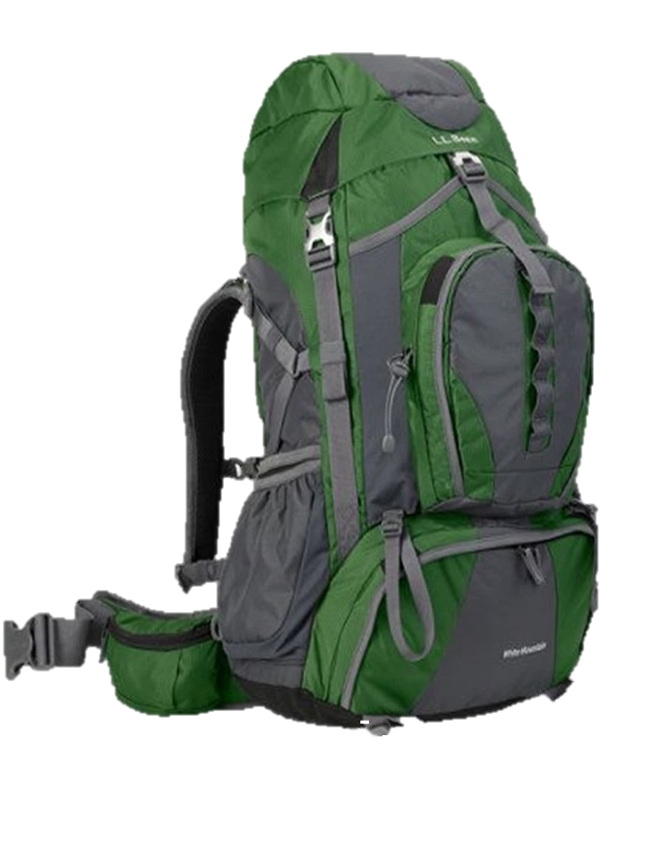

NEW MEMBER COORDINATORS
EXPLAIN DIFFERENCES BETWEEN
PACKS TROOPS
Notes:
Families can be confused about how PACKS are different from TROOPS, the different activities, the different level of responsibility, the different level of interaction between the youth and the leaders. New Member Coordinates can help new families understand these differences in a way that welcomes their questions, helps them understand some level of “adjustment” is typical, and encourage them to be involved with the troop.

Slide 42








NEW MEMBER COORDINATORS
Religion
Classes
explain
Scouting is
compatible
and
adaptable
with other
youth
activities.
Notes:
Some families leave Scouting due to a lack of understanding of how Scouting can “fit-in” with other extra-curricular activities, from sports to music to religion classes and more. A New Member Coordinator can be instrumental in explaining how Scouting is compatible with a wide range of other youth activities. They can share that most Scouts do participate in other activities by providing examples of how those families make it all work.
New Member Coordinators are the solution to many of the issues troops face when integrating new families into the Scouting program.

Slide 43

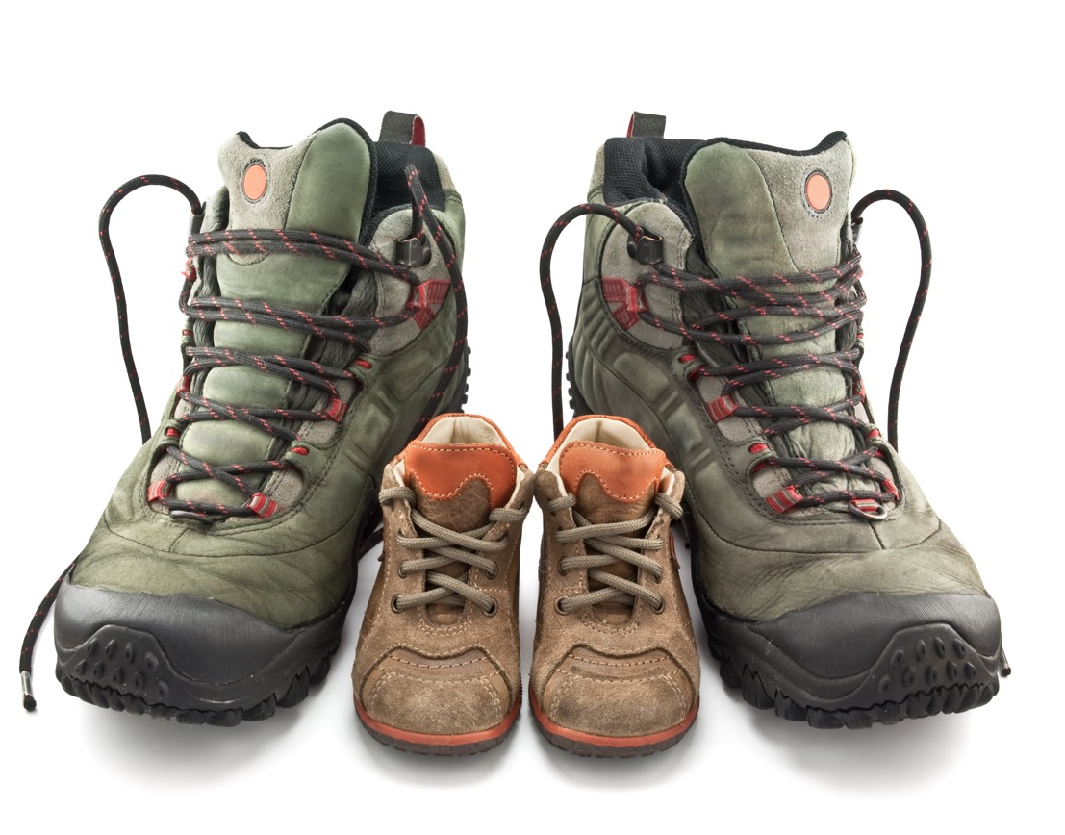
clarify
changing
parental
roles
as youth
develop
and grow
Notes:
Parents new to Scouting are often confused as how to balance their changing parental role between strong support from mom, dad and other leaders and increasing independence for the growing, maturing youth. A New Member Coordinate can guide parents through this transition.

Slide 44

NEW MEMBER COORDINATORS
explain
how the “controlled chaos” of a troop meeting helps youth grow and develop
Notes:
For parents new to Scouting, a troop meeting may seem like an exercise in “controlled chaos”. There’s a lot of activity, and it can look very unstructured at first. A New Member Coordinator can be instrumental in explaining the concept of a “youth-led” troop, the patrol method, and even why letting youth experience both the successes and failures that come with learning new skills is a valuable step in teaching our Scouts.

Slide 45

NEW MEMBER COORDINATORS
explain how both moms and dads can contribute to troop program.
Notes:
Oftentimes moms are concerned they won’t feel comfortable or welcome in troop program.
A New Member Coordinator, especially another mom, can help dispel that myth and serve as a helpful resource. The New Member Coordinator can also coach moms on how they can help their Scouts be successful, encouraging their child to be independent and take advantage of leadership opportunities.

Slide 46


NEW MEMBER COORDINATORS
help parents find
the information
THEY need
TOO
MUCH
TOO
LITTLE
JUST
RIGHT
Notes:
It’s not difficult for new parents to become easily overwhelmed by the fire hose of new information when joining a troop. An enthusiastic New Member Coordinator assists parents as they navigate the information flow, translate Scouting jargon, and ensure families are aware of the events, activities and programs relevant to their Scout. New Member Coordinators are there to ensure parents have sufficient information about RELEVANT upcoming activities, immediately engaging new youth. All of this helps the new Scout become engaged with the Scouting program right away, and spares families confusion and uncertainty about what is important to their family.

Slide 47

NEW MEMBER COORDINATORS
Help
“NEW” campers
know what they really need!
Notes:
The term “first time campers” can apply to the adults as well as the youth. Even if parents have camped before, it may have been a long time ago. New Member Coordinators can assist with sorting out the “must-haves” from the “not needed yet” or even the “not needed ever” list of camping equipment. A camping essentials suggestion list can help a new Scout or Scouter shop with confidence that they are purchasing what they really need. On those first several campouts with the Troop, new adults can benefit from the New Member Coordinator’s guidance on the “troop way” of doing things, and the reasoning behind what is common practice for your unit.

Slide 48

NEW MEMBER COORDINATORS
HELP WITH
Notes:
One reasons some families leave Scouting early on is a lack of engagement with the program. They don’t feel connect or involved, they experience too much confusion and may feel like the “outsider” looking in. A New Member Coordinator’s MAIN FOCUS is actively engaging with new families when they join, to help bridge the gap between “rookie” and “veteran” Scouter. Having a “go-to” person to answer questions and point a new parent or Scout in the right direction may make all the difference to a youth staying in the program.

Slide 49


ONLINE
TRAINING
https://my.scouting.org
Notes:
The good news is you can find adult volunteer training online at the link on your screen: my.scouting.org Just click on the BSA Learn Center and choose the New Member Coordinator It’s easy, short, and best of all: NO TESTS!

Slide 50



TRAINING STARTS WITH
MODULE
Notes:
Begin your training with the WELCOME module available online at Scouting U, the BSA’s Learn Center. This Welcome module highlights what a New Member Coordinator does, and is sufficient to get started in your new role. Additional courses are also available.

Slide 51
WHAT A
WONDERFUL
SENSE OF
COMMUNITY
YOU’LL CREATE
FOR THE FAMILIES
IN YOUR TROOP!

Slide 52
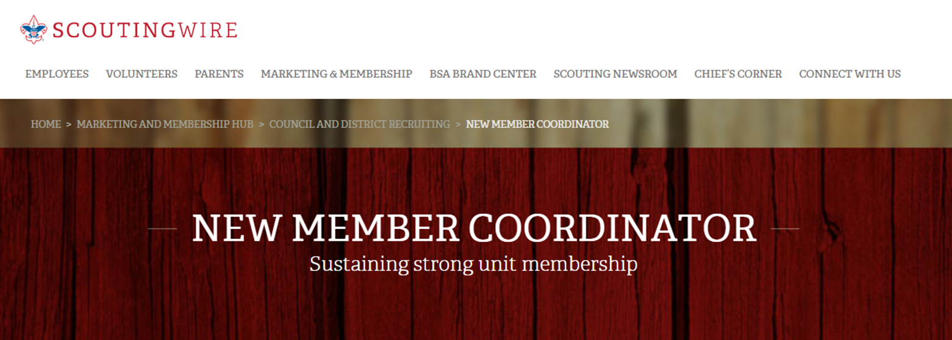
LEARN MORE
www.scouting.org/NMC
+
VISIT THE NEW MEMBER COORDINATOR
GROUP ON FACEBOOK
Notes:
Please be sure to check out the other great resources available on the New Member Coordinator website at the link on the screen.
On the website, there are downloadable formats for the WELCOME LOGO and embroidery, information on INCENTIVES for units, districts and councils to adopt the New Member Coordinator position, webinars and much, much more.
[This is the latest available screen shot of the webpage - may need to be updated.]

Slide 53

We can help you make that happen.
Please keep in touch.
NAME:
PHONE:
EMAIL:
District/Council:
Notes:
(Personalize presenter’s name and contact information on slide, prior to presentation. Revise closing remarks below to suit the setting and audience.)
Thank you for your time and attention today. I hope you are all as excited about how New Member Coordinators can help your troop as I am.
I invite you to share this presentation with your unit’s leadership and others. It’s exciting and it WILL MAKE A DIFFERENCE.

Slide 54
TO THE PRESENTER(S):
Some audience members may ask HOW TO access their WELCOME MODULE once they get home or even want to access it right way.
Instructions on HOW TO access the WELCOME MODULE are available on the NMC website. Participants can follow the active link to WELCOME COURSE INSTRUCTIONS on the webpage.
These instructions are reproduced, for your convenience, on the following slides. They are not intended for viewing in a large group setting … but rather can help any interested parties navigate to the site … individually or in a small group after the main presentation.
Notes:
Click to add notes.

Slide 55
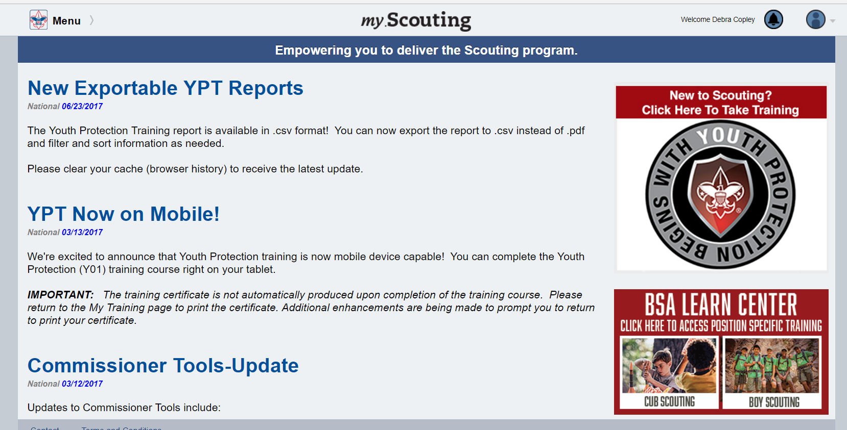
1. GO TO my.scouting.org (create account or sign-in)
2. CLICK on BSA LEARN CENTER graphic
Notes:
Click to add notes.

Slide 56

3. CLICK on NEW MEMBER COORDINATOR
(under PROGRAM SPECIFIC TRAINING)
Notes:
Click to add notes.

Slide 57
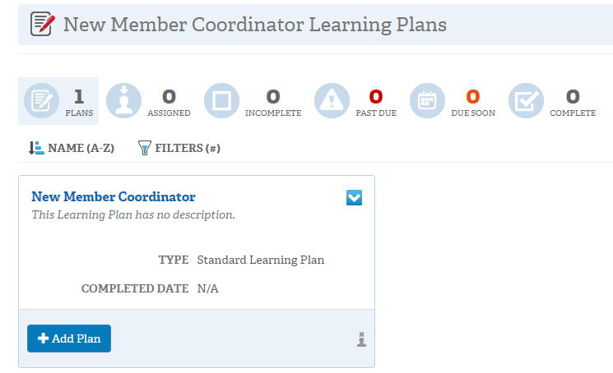
4. CLICK on “+ ADD PLAN” button
Notes:
Click to add notes.

Slide 58
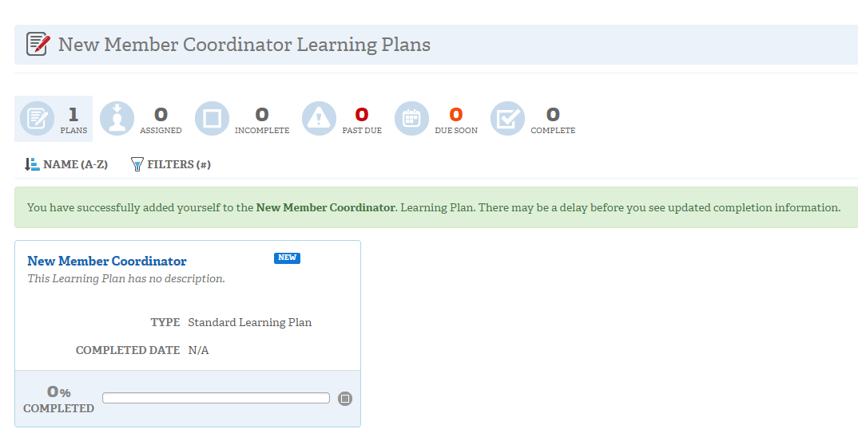
5. You will receive a confirmation message.
CLICK on NEW MEMBER COORDINATOR
to continue to training.
Notes:
Click to add notes.

